Slide 1
Power Grids
Natural Disasters vs. Cyber Attacks
Group #1
James Cogswell, Andrew Ganous, Claire Allen, and Parastou Moghaddam

Slide 2
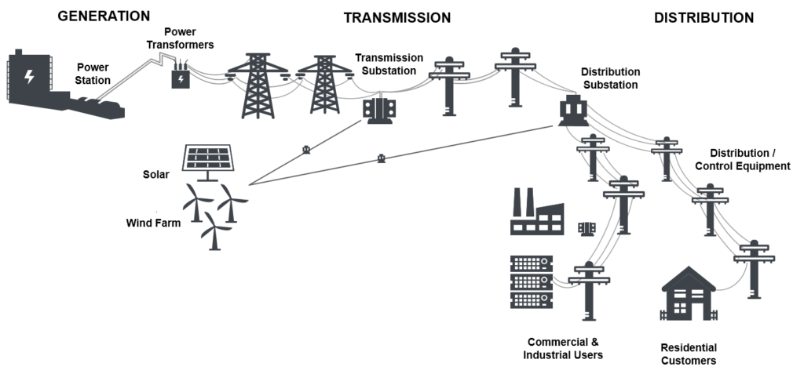
Abstract
Presidential Policy Directive (PPD)-21 identified the energy sector which includes the power grid as one of 16 critical infrastructure sectors
The U.S. electricity system is a complex system of systems
These systems still rely on legacy systems
Supervisory Control and Data Acquisition (SCADA) were first implemented in the 1970s at a time when many vulnerabilities did not exist

Slide 3
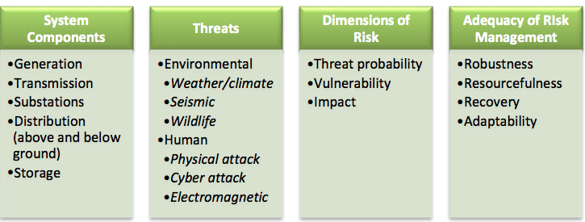
Power Grid System Resiliency
“Strengthening the security and resilience” of critical systems is crucial as highlighted in PPD-8.
Resiliency of electricity system is explored through system components, threats, dimensions of risk, and adequacy of risk management
Notes:
strengthening the security and resilience of the United States through systematic preparation for the threats that pose the greatest risk to the security of the nation, including acts of terrorism, cyber attacks, pandemics, and catastrophic natural disasters.

Slide 4
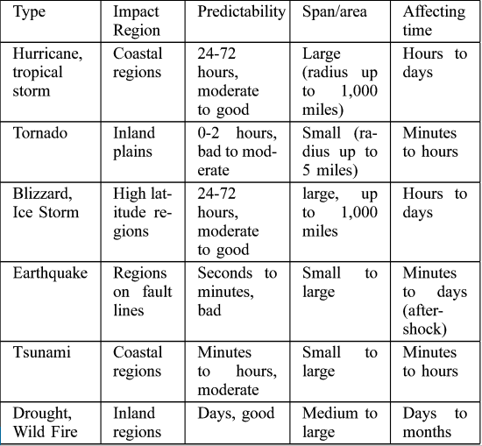
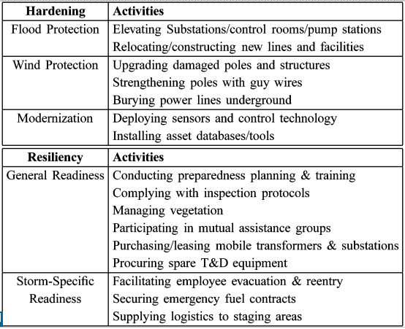
Natural Disasters [1]
Notes:
Unlike most cyber attacks, natural disasters each have a degree of predictability. As shown in the graph on the left, the disasters are categorized into geographical locations, predictability, degree of severity, and duration time. Forecasting allows electrical maintenance companies and engineers to make preparations to increase the resiliency and decrease the recovery times of power grids. Hurricanes, for example, can be predicted up to three days before they occur. Power lines can be downed by the powerful winds, so maintenance workers would be able to strengthen or bury power lines to mitigate the effects, as shown in the graph on the right. Additionally, cities bordering coastlines can expect some tropical storm weather, so power lines would be strengthened and prepared accordingly, as the weather is inevitable.

Slide 5
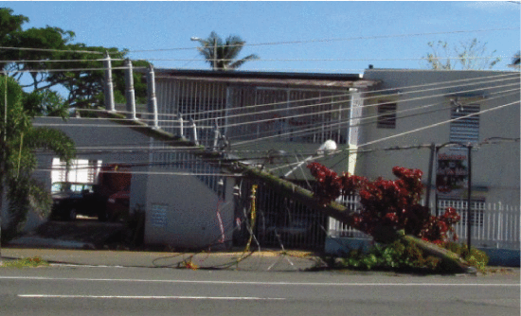
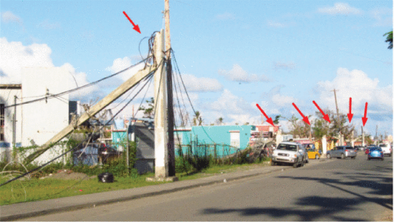
Natural Disasters [2]
Hurricane Maria
Sustained 125 mph winds damaged transmission lines, wind turbines
Flooding damaged power plants, generators, substations
Notes:
For example, Hurricane Maria wreaked havoc on Puerto Rico’s electrical grid. 125 mph sustained winds knocked down transmission lines and disabled them, preventing thousands of citizens in San Juan and beyond from receiving power. Additionally, power plants and substations were damaged by floodwaters.

Slide 6
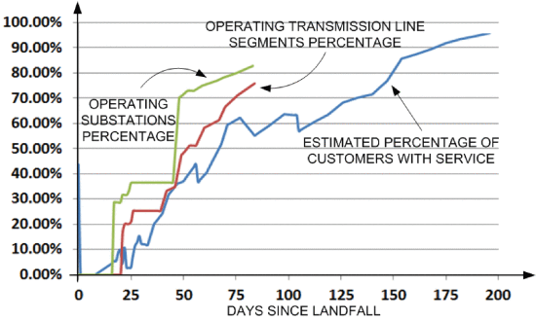
Natural Disasters [3]
Hurricane Maria Recovery
Private power plants contributed to city power
Mobile transformers and generators deployed
Temporary transmission poles constructed
Personal fossil-fueled generators most common
Notes:
After the hurricane had passed, efforts were made to restore power. Several power plants were out of commission and one was flooded, so temporary, personal generators were the most common temporary solution to the outages. Private power plants and those that had emerged unscathed contributed to electrical islanding, in which cities were connected to utilize a single power source. Temporary transmission poles were constructed to carry this power, though this is not a common mitigation technique. In the graph on the right, we can quantify how long the recovery took. The percentage of operating substations rose well before the percentage of customers with service, likely because the downed transmission lines prevented that power from being shared. The graph follows a logical recovery plan, as the substations are repaired, then the lines, and then finally the customers receive power. The first step was to provide the citizens with temporary methods of gaining power to buy time for the substations and lines to be repaired without citizens going completely without power.

Slide 7
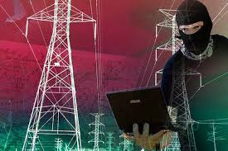
Cyber Attacks [1]
The electrical infrastructure in the United States is extremely vulnerable to cyber attacks. Large regions of the NA electrical grid are interconnected.
Several leaders in the DoE and other agencies have openly admitted that the US is neither prepared for cyber attacks on our electrical infrastructure nor do we have a plan to recover from one.
Sec. of Energy Rick Perry - “I will tell you that I am not confident that the Federal Government has a broad strategy in place.”
Millions could be left without water, transportation, waste disposal for weeks or even months.
“The scenario of losing power for a long time – weeks or even months – is not unthinkable.” (Stuart Madnick, hbr.org)
Notes:
James

Slide 8
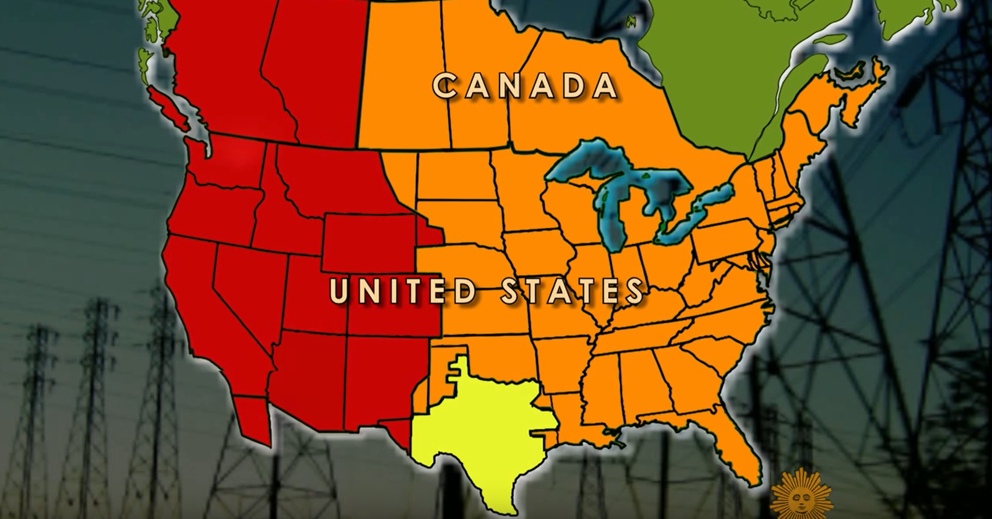
Notes:
James

Slide 9

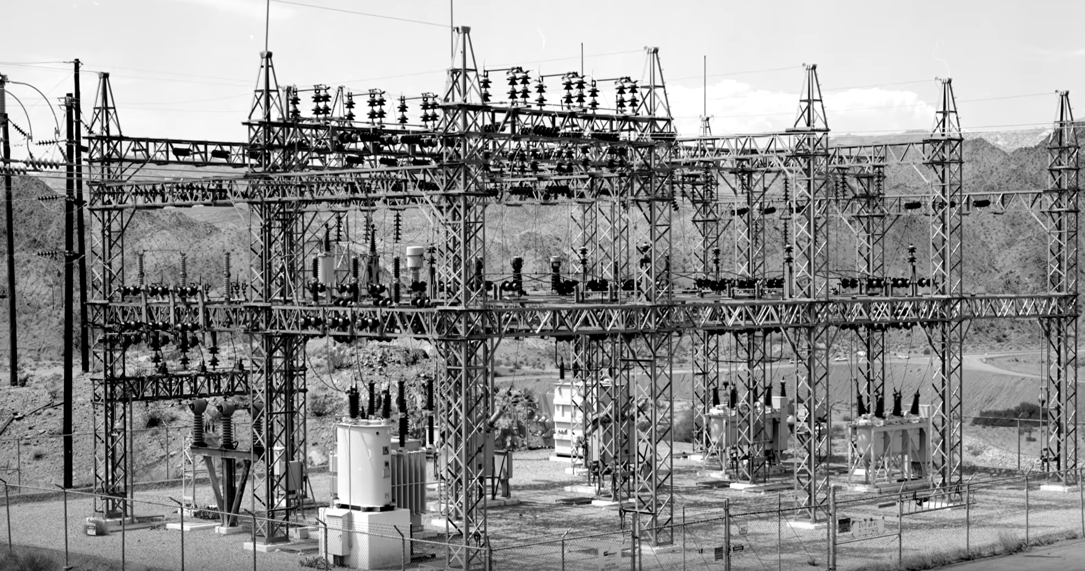
Cyber Attacks [2]
The grid is not only vulnerable to being shut down, but also in danger of complete destruction of some components.
Transformers cost several millions of dollars and many years to build. (CNBC)
No backups/spares. Need fully customized rebuilds if one is destroyed.
Russia has already penetrated our electrical infrastructure.
They took out Ukraine’s electrical infrastructure in a cyber attack in 2016.
US grid is more modern, and therefore, more automated. This modernization increases security in some ways and makes us more vulnerable to massive damage.
Although the US grid would be harder to take down, it may be easier to keep it down.
Notes:
James

Slide 10
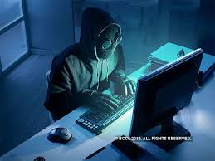
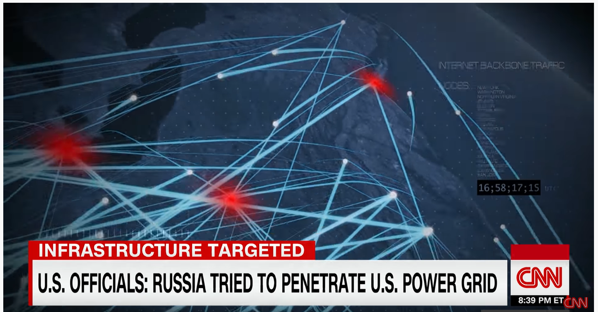
Cyber Attacks [3]
DHS and FBI have detailed a 2-year, multi-staged effort by Moscow targeting the US energy grid. (CNN)
Russian attackers targeted small energy-related businesses and injected malware.
Once inside these companies, the Russians collected information on facility control systems and attempted to acquire the ability to turn those systems off.
Goal was to identify targets and position malware so they could “pull the trigger” if they chose to. Also an attempt to send the US a powerful message.
Russia also targeted other areas of US infrastructure including nuclear power, water, avation, and manufacturing.
Notes:
James

Slide 11
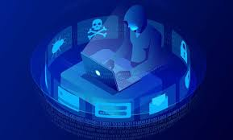
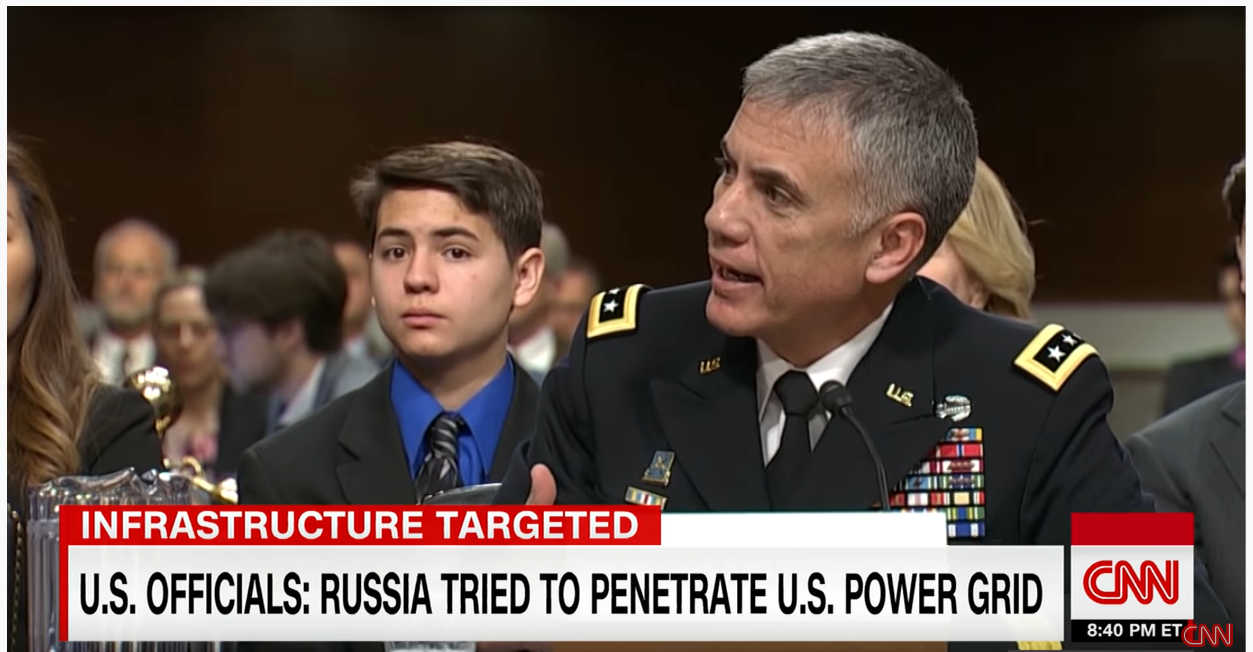
Cyber Attacks [4]
When asked whether the Russians would fear the US retaliation in the event of a large-scale cyber attack on our electrical infrastructure -
“I would say right now - they don’t think much would happen. They don’t fear us.”
President Trump’s nominee for Director of the NSA and US Cyber Command
Notes:
James

Slide 12
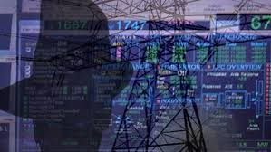
Critical Systems
Natural Disasters vs. Cyber Attacks
Natural Disasters
System disruption occurs randomly
Can only disrupt the service
Accompanied by other damage which can impede repair of damaged system components (fallen trees, wildfires etc.)
Can take weeks to restore entire grid
Cyber Attacks
Likely to be timed and targeted to cause maximum amount of damage and disruption
May disrupt the service, alter system information, or take total control of the system
System restoration often most immediate priority
Restoration can be accomplished within hours or take as many as months in a catastrophic cyber attack
Notes:
Andrew
Please focus on the differences between both and compare and contrast how they differ, what are the effects to critical infrastructure.
-Where do we draw the line to figure out which would be more devastating than the other?

Slide 13
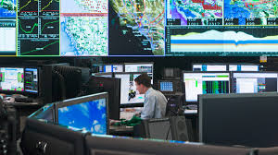
Mitigation Strategies
Natural Disasters vs. Cyber Attacks
Natural Disasters
The ability to forecast or at least anticipate natural risks helps to design and deploy a cost-effective risk management system.
Countermeasures are resilient and redundant infrastructure and contingency plans
City response can provide some level of risk mitigation at no immediate cost to power companies (fire-fighting, levies to prevent flooding)
Certain types of natural disasters are more likely to occur in a region than others making it possible to prepare for probable types of damage
Cyber Attacks
Only the attackers know for sure an attack will occur so constant vigilance is the most important defense
Firewalls, data encryption and intrusion detection software are necessary countermeasures
Cost of mitigation is entirely on the entities controlling equipment unless emergency is declared
Probability of a specific type of attacks depends on the exploitability of system components and the function of these components
Notes:
Andrew

Slide 14
References
Boyer, B. R. (2011). Identification and ranking of critical assets within an electrical grid under threat of cyber attack (Order No. 1500336). Available from ProQuest Dissertations & Theses Global. (897938247). Retrieved from https://search-proquest-com.mutex.gmu.edu/docview/897938247?accountid=14541
CBS Sunday Morning. (2015, November 1). Can cyber-hackers shut down the power grid?. Retrieved from https://www.youtube.com/watch?v=z2-rkZOL8C4&list=TLPQMDgwMjIwMjACL3uho-zzLw&index=3.
CNBC. (2017, July 5). Russian Hackers Take Down The Power Grid | CNBC. Retrieved from https://www.youtube.com/watch?v=3is-AzwPoC8.
CNN. (2018, March 17). US blames Russia for cyberattacks on power grid. Retrieved from https://www.youtube.com/watch?v=GjsesbT7U-o.
Kwasinski, A., Andrade, F., Castro-Sitiriche, M., & O’Neill-Carrillo, E. (2019. February 19). Hurricane Maria Effects on Puerto Rico Electric Power Infrastructure. IEEE Power and Energy Technology Systems Journal, 6(1), 85-94. Retrieved from https://ieeexplore.ieee.org/document/8644031.
Madnick, S. (2018, February 6). Preparing for the Cyberattack That Will Knock Out U.S. Power Grids. Retrieved from https://hbr.org/2017/05/preparing-for-the-cyberattack-that-will-knock-out-u-s-power-grids
Preston, B.L, Backhaus, S.N., Philips, J.L, Ewers, M., Silva-Monory C.A,. Dagle, et al. (2016). Resilience of the U.S. electricity system: a multi-hazard perspective. Retrieved from https://www.energy.gov/sites/prod/files/2017/01/f34/Resilience%20of%20the%20U.S.%20Electricity %20System%20A%20Multi-Hazard%20Perspective.pdf
Sobczak, B. (2019). SECURITY: Report reveals play-by-play of first U.S. grid cyberattack. Retrieved from https://www.eenews.net/stories/1061111289
Wang, Y., Chen, C., Wang, J., & Baldick, R. (2015, May 12). Research on Resilience of Power Systems Under Natural Disasters - A Review. IEEE Transactions on Power Systems, 31(2), 1604-1613. Retrieved from https://ieeexplore.ieee.org/abstract/document/7105972

